Slide 1


Lecture 1: Java Basics and Object Oriented Concepts & Programming Qurratulain Malik qmalik@keyin.com

Slide 2
Introductions Getting to know you
Say hello to everyone and introduce your self to me
how much you hate or love programming ☺
what you have enjoyed the most about programming courses so far
what you are looking forward to learn in this course
About me
Teaching is all I have done so far in my life :)

Slide 3
Java Types (data types)
Java has two basic types
Primitive types
Reference Types
Primitive types - Primitive Data types in java are those data types that specify type and size of data but does not provide any additional methods
integers, floating point numbers, characters, etc
Refer to actual values
Reference types - In Java, a reference data type is a variable that can contain the reference or an address of the dynamically created object. These type of data type are not predefined like a primitive data type.
Arrays, Classes, Objects, etc
Refer to memory locations (by name, not location)
Notes:
Primitive types are basic values. References types are structures (arrays, classes, objects, etc). A reference is as close as Java gets to a C pointer, but references are accessed by name and not by location.
A Java programmer has no control over memory allocations, locations, etc.
Ideally in an OO language everything would be an object of some form, and Java does have objects that represent the kinds of values that can be stored in primitive types. However reference types take up more memory so for efficiency, Java allows values to be stored in a primitive form.

Slide 4
Primitive Types
Type | Description | Size
Boolean (boolean) | True/false value | 1 bit
Byte (byte) | Byte-length integer | 1 byte
Short (short) | Short integer | 2 bytes
Integer (int) | Integer | 4 bytes
Long (long) | Long Integer | 8 bytes
Float (float) | Single precision floating point number | 4 bytes
Double (double) | Double precision float | 8 bytes
Char (char) | Single character | 2 bytes

Slide 5
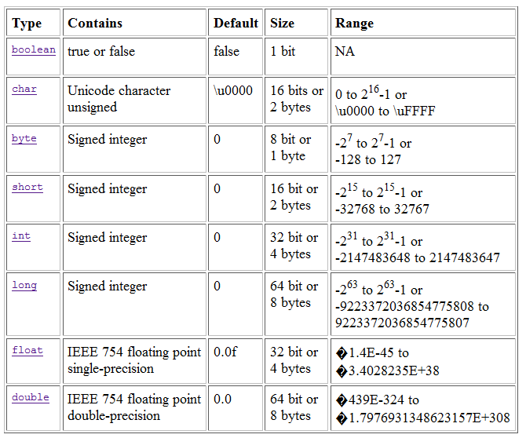
Java Basic Types

Slide 6
Naming
All Java syntax is case sensitive
Valid Java names
Consist of letters, numbers, underscore, and dollar
Names can only start with letter or underscore
E.g. firstAttribute but not 1stAttribute
“Camel case” convention
Java encourages long, explanatory names
Start with a lower case letter, with words capitalised
E.g. thisIsCamelCase, andSoIsThisAsWell
Notes:
Meaningful names are an important way to make your code understandable. While the later examples don’t always follow that recommendation, that’s just to save space on the slides.
Camel case is also recommended as it makes long identifier names much more readable. It’s called camel case because there are humps in the words!
Note that there are naming conventions for method names and variables also (see later slides)

Slide 7
Naming Guidelines
The rules for variable names and identifiers follow the same conventions as C:
Variables and methods must start with lowercase
double x;
int sessionalMarks=0;
public void accountDetails();
studentMarks is preferred to student-marks
Class names must start with uppercase
public class HelloWorld{}

Slide 8
Naming Guidelines (Contd)
Lower Camel Case: Each new word begins with a capital letter except the first letter of the name is in lowercase (e.g., hasChildren, customerFirstName, customerLastName).
Using proper naming convention increases the readability of your program.
Use pronounceable names
Be brief
calculateArea instead of calculateTheAreaOfRectangle

Slide 9
Syntax Examples (Variables)
int anInteger;
Boolean isSwitchOn;
Variables can be initialised when they are declared
int anInteger = 10;
boolean isSwitchOn = true;

Slide 10
Java for Beginners
Java class name is also called identifier
Reserved words or keywords are reserved by java and cannot be used as identifiers
Identifier may contain letters, dollar sign, underscores, digits and letters
Identifier does not begin with a digit
Identifier does not contain spaces
Valid Identifiers | Invalid Identifiers
_Hello | 1Name
Hello_World | Hello World
Name1

Slide 11
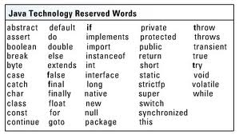
Java Reserved Words
Reserved words cannot be used as identifiers.

Slide 12
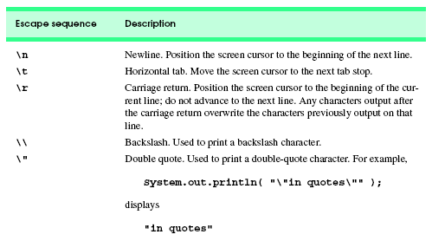
Escape Sequences in Java
Backslash (\) is called an escape character.
When a backslash appears in string of characters. Java combines the next character with the backslash to form an escape sequence.

Slide 13
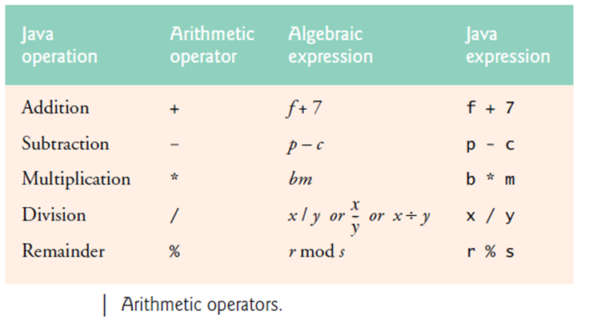
Arithmetic Operators

Slide 14
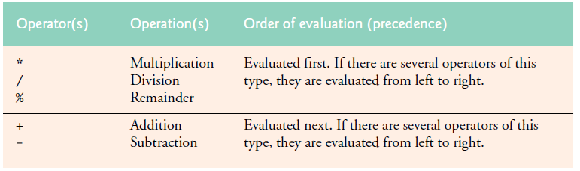
Precedence of Arithmetic Operators

Slide 15
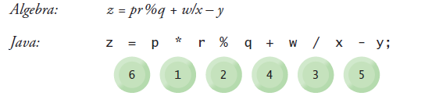
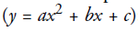
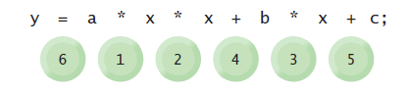
Precedence of Arithmetic Operators (Contd)

Slide 16
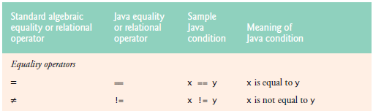
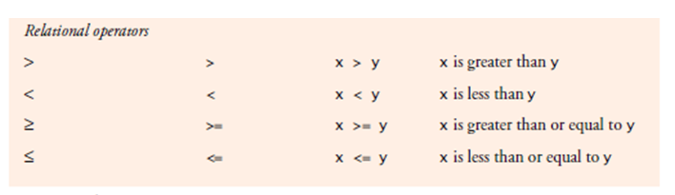
Equality and Relational Operators

Slide 17
Basic Addition Program
import java.util.Scanner ;
public class Addition
{
public static void main (String[] args)
{
Scanner input = new Scanner (System.in);
int num1, num2, sum;
System.out.println (“Enter first number:");
num1 = input.nextInt();
System.out.println (“Enter second number:");
num2 = input.nextInt();
sum = num1 + num2 ;
System.out.printf ("sum = %d\n", sum);
}
}

Slide 18
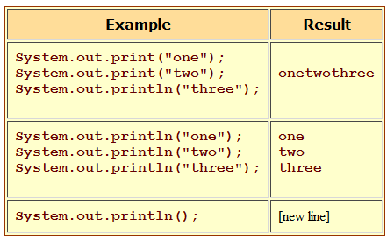
Print statements
There are three kinds of print statements:
System.out.print(argument) just prints out its argument, and
System.out.println(argument) prints out its argument and ends the line.
A third kind, System.out.printf(format, arguments), gives more control over how things are printed.

Slide 19
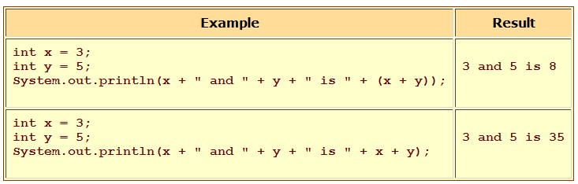
Print statements (contd)

Slide 20
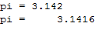
Print statements (contd)
Numerical values are formatted according to format specifiers like those for the printf() function in C.
Format Specifiers: %b boolean, %c character, %d integer %f floating point
%s string, %n a new line
Example:
double pi = Math.PI;
System.out.printf ("pi = %5.3f", pi);
System.out.println();
System.out.printf ("pi = %10.4f", pi);
Output

Slide 21
Syntax Examples (if)
if (x == y)
{
//executes if true
}
if (somethingIsTrue())
{
doSomething();
}
else
{
doSomethingElse();
}

Slide 22
Example (for)
int x=0;
for (int i=1; i<=10; i++)
{
//code to repeat ten times
x = x + i;
}

Slide 23
Example (while)
int x=0;
while (x < 10)
{
doSomething();
x++;
}
//loop forever
while (true)
{
}

Slide 24
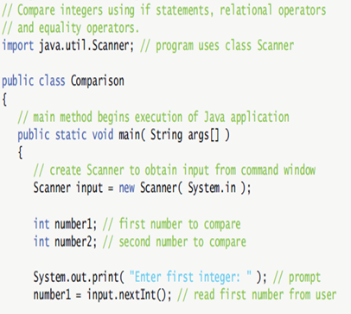
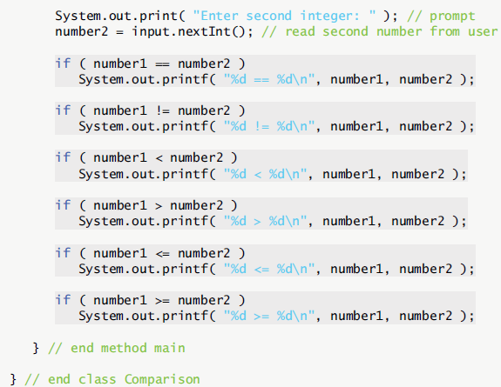
Simple Program with Equality and Relational Operators

Slide 25
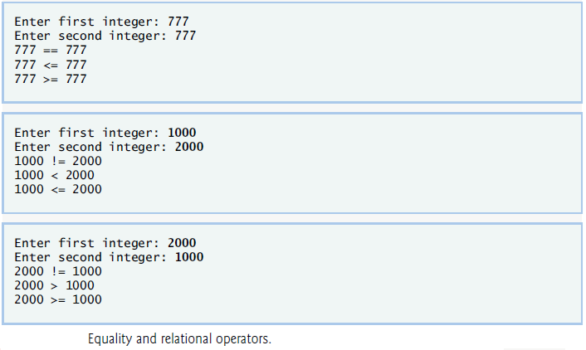
Output

Slide 26
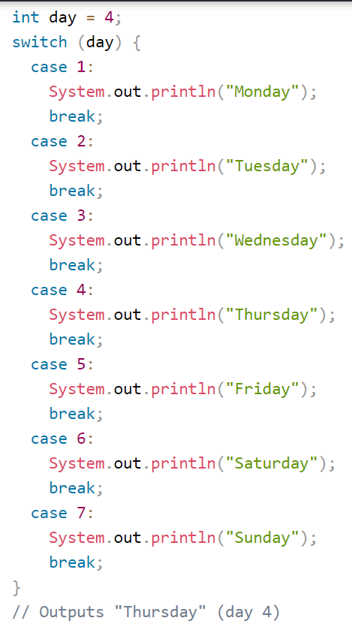
Java Switch
switch(expression) {
case x: // code block break; case y: // code block break; default: // code block
}
Example →

Slide 27
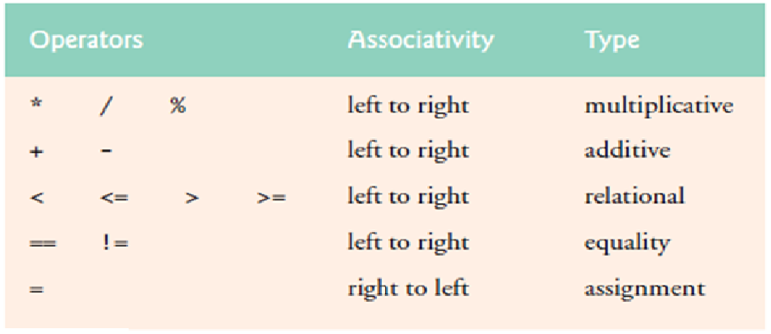
Precedence and Associativity of Operations

Slide 28
OO Programming Concepts
Object-oriented programming (OOP) involves programming using objects.
An object represents an entity in the real world that can be distinctly identified. For example, a student, a desk, a circle, a button, and even a loan can all be viewed as objects.
An object has a unique identity, state, and behaviors.
The state of an object consists of a set of data fields (also known as properties) with their current values.
The behavior of an object is defined by a set of methods.

Slide 29
Objects
An object has both a state and behavior. The state defines the object, and the behavior defines what the object does.

Slide 30
Object
Objects are key to understanding object-oriented technology.
Examples of real-world objects: your dog, your desk, your television set, your bicycle.
Real-world objects share two characteristics: They all have state and behavior.
Dogs have state (name, color, breed, hungry) and behavior (barking, fetching, wagging tail).
Bicycles also have state (current gear, current pedal cadence, current speed) and behavior (changing gear, changing pedal cadence, applying brakes).
Identifying the state and behavior for real-world objects is a great way to begin thinking in terms of object-oriented programming.

Slide 31
Objects (Contd)
Take a minute right now to observe the real-world objects that are in your immediate area.
For each object that you see, ask yourself two questions:
"What possible states can this object be in?"
"What possible behavior can this object perform?“
Real-world objects vary in complexity;
your desktop lamp may have only two possible states (on and off) and two possible behaviors (turn on, turn off),
Desktop radio might have additional states (on, off, current volume, current station) and behavior (turn on, turn off, increase volume, decrease volume, seek, scan, and tune).

Slide 32
Class
A class is the blueprint from which individual objects are created.
In object-oriented terms, we say that your bicycle is an instance of the class of objects known as bicycles.

Slide 33
Classes and Objects
Classes:
People,books,dogs,cats,cars,airplanes,trains,etc.
Instance of a class
You, your parents, the book you are reading, the car you drive
Example: Car class
Property names Method Names
model startEngine
year stopEngine
Color accelerate

Slide 35
Thinking About Objects: Introduction to Object Technology and the Unified Modeling Language
Object orientation
Unified Modeling Language (UML) - Flexible and extendible graphical language that uses common notation
UML is a diagramming tool for describing and documenting object oriented applications
Programming language independent
Used for modelling an application before its engineered
Twelve different diagrams in all, with many complex details
We’ll be covering just class diagrams
Very useful for describing APIs and discussing OO applications

Slide 36




More on Classes and Objects
A Java program consists of one or more classes
A class is an abstract description of objects
Class is a template for an object
Class defines a new data type
Once defined, this new data type can be used to create objects of that type
An object is instance of a class.
Because an object is an instance of a class, you will often see the two words object and instance interchangeably
Here is an example class:
class Dog { ...description of a dog goes here... }
Here are some objects of that class:

Slide 37
Thinking About Objects, classes and class diagrams
Objects
Reusable software components that model real-world items
Look all around you
People, animals, plants, cars, etc.
Attributes
Size, shape, color, weight, etc.
Behaviors
Babies cry, crawl, sleep, etc.
Class Diagrams
Describe classes and interfaces
…their properties
…their public interface
…and their relationships (e.g. inheritance, aggregation

Slide 38
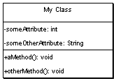
UML -- Classes
Box with 3 sections
The top contains the class name
The middle lists the classes attributes
The bottom lists the classes methods
Can indicate parameters and return types to methods, as well as their visibility

Slide 39
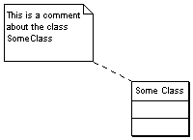
UML -- Comments
Useful for adding text for the readers of your diagram
The symbol looks like a little post-it note, with a dotted line joining it to the class or relationship that its describing

Slide 40
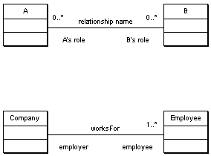
UML -- Association
A line between two classes indicates a relationship
Extra information can be added to describe the relationship
Including
Its name
The roles that the classes play
The cardinality of the relationship (how many objects are involved)
E.g. a Person worksFor a Company, which has many employees

Slide 41
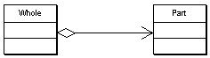
UML -- Aggregation
Aggregation (a whole-part relationship) is shown by a line with clear diamond.
As aggregation is a form of relationship you can also add the usual extra information
I.e.
Name
Roles
Cardinality

Slide 42
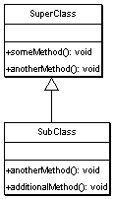
UML -- Inheritance
Inheritance is shown by a solid arrow from the sub-class to the super-class
The sub-class doesn’t list its super-class attributes or methods,
unless its providing its own alternate version (I.e. is extending the behaviour of the base class)

Slide 43
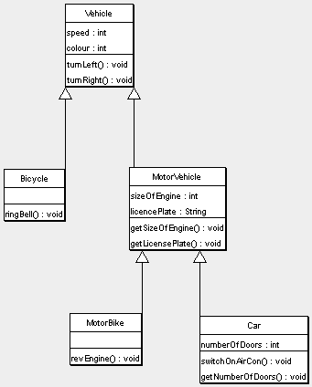
Example #1

Slide 44
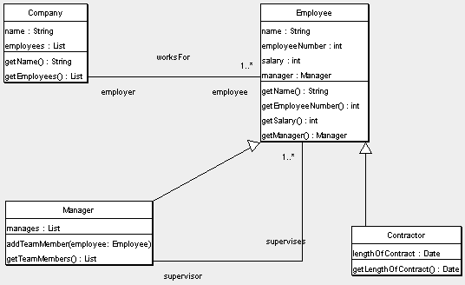
Example #2

Slide 45
Thank you Enjoy Coding in Java

